Slide 1

SEG2102 Database Management Systems
Overview of Database Management systems (DBMSs)

Slide 2

Outline
Definitions
Database Management System - Definition and Functionalities
Properties of Database
A simplified database environment
Example of University database
Year 1
Year 2

Slide 3
Definitions
Data - Raw, Unprocessed facts
Ex: 25, Alice, Kuala Lumpur
Information – Processed data
Ex : Age of Alice is 25
Database – Collection of related data
Ex : Online banking system, Library management system
Metadata – data about data or database definition
Ex : File names and Permissions in a file system
Notes:
Data – Any raw or unprocessed facts you record. Example it can be a number, name, city, text, images, video.
Information – Unprcessed data proceesed to make a meaningful context

Slide 4
Database Management Systems
Definition: Collection of programs that enables users to create and maintain the database
Functionalities:
Define : Specifying the data type, structures and constraints for data to be stored.
Construct : Process of storing data on some storage medium
Manipulate : Querying the database to retrieve specific data, updating database and generating reports
Share : allows multiple users and programs to access the database concurrently
#A discipline that focuses on the proper data creation and manipulation, and administration for database system performance, controlling access and storage of databases.

Slide 5
Properties of database
A database represents some aspects of the real world (miniworld)
A database is a logically coherent collection of data with some inherent meaning.
A database is designed, built and populated with data, for a specific purpose

Slide 6
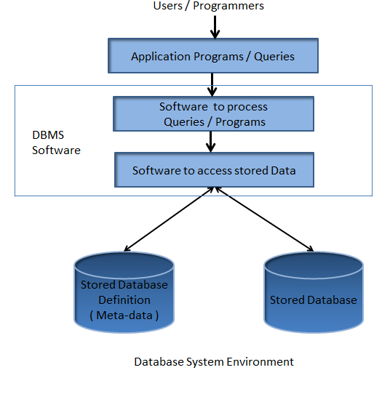
DB System Environment

Slide 7
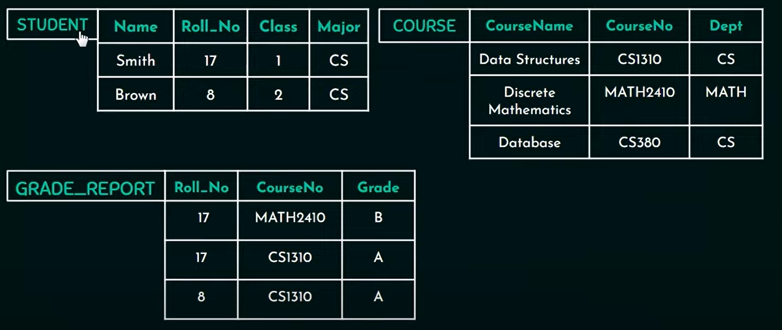
A database that stores student and course information

Slide 8
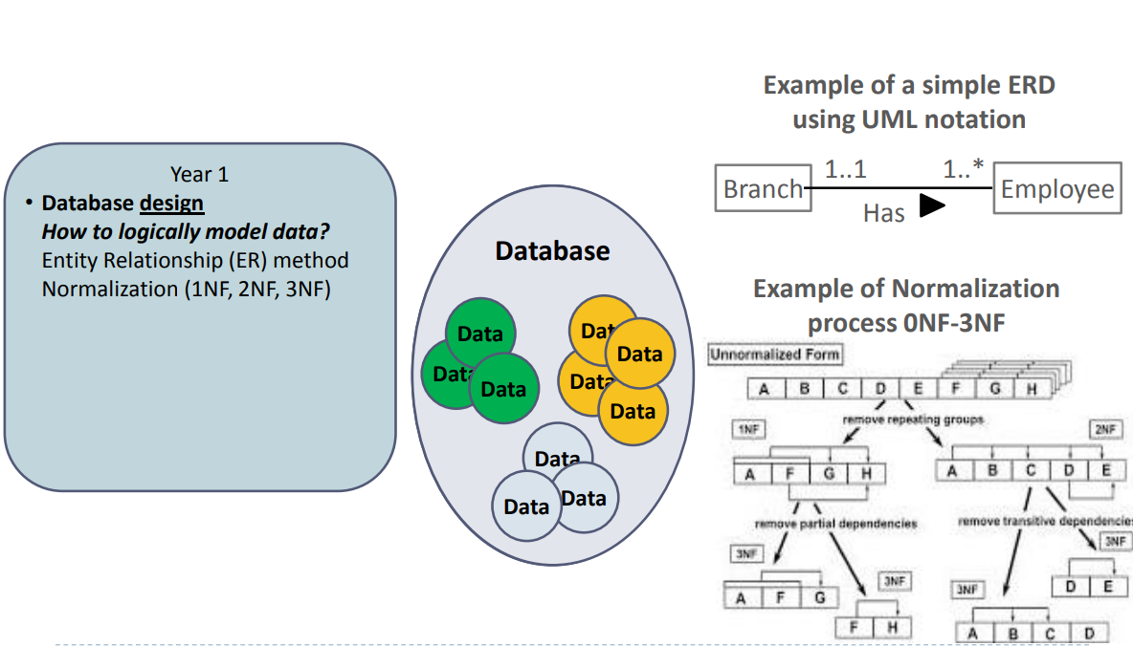
Year 1

Slide 9
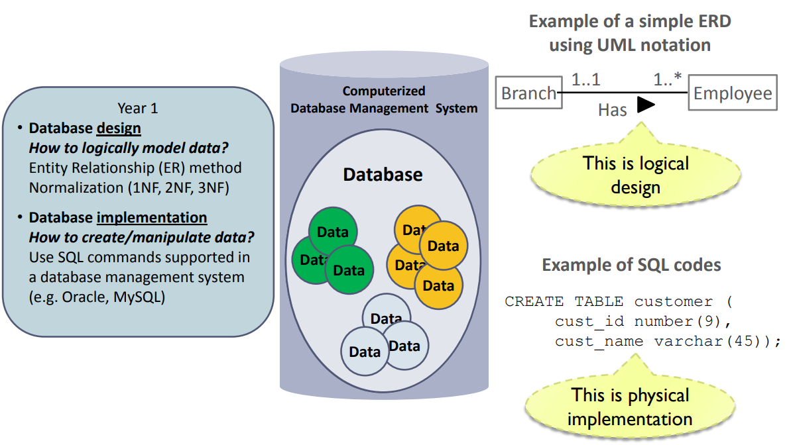
Year 1

Slide 10
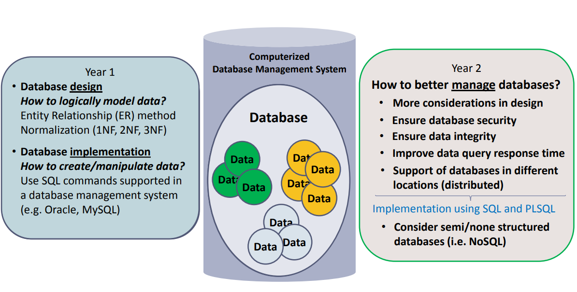
Year 2 SEG2102 Database Management Systems

Slide 11
Database Management System (DBMS)
Databases are managed through a computerized Database Management System (DBMS)
 A DBMS is a software system that consists of computer programs with the following essential functions:
Allows users to define and create the database through Data Definition Language (DDL)
Allows users to insert, update, delete and retrieve data from the database through Data Manipulation Language (DML) Difference Between DDL and DML in DBMS - GeeksforGeeks
Provides database controls & optimize performance
Allows database distribution and data sharing among multiple applications or users (through programming interfaces)
 A DBMS makes data management more efficient
 Example products: Oracle, MySQL, Redis, Cassandra, HBase, MongoDB, Neo4j

Slide 12

Discussion

